Slide 1
HPE PM 2.0 Design
JS & Neo4J
Zhigang Yan
Dec 12nd, 2015
Notes:
This is a sample Title Slide with Picture ideal for including a dark picture with a brief title and subtitle.
A selection of pre-approved title slides are available in the HPE Title Slide Library. The location of the library will be communicated later.
To insert a slide with a different picture from the HPE Title Slide Library:
Open the file HPE_16x9_Title_Slide_Library.pptx
From the Slide thumbnails pane, select the slide with the picture you would like to use in your presentation and click Copy (Ctrl+C)
Open a copy of the new HPE 16x9 template (Standard or Events) or your current presentation
In the Slide thumbnails pane, click Paste (Ctrl+V)
A Paste Options clipboard icon will appear. Click the icon and select Keep Source Formatting. (Ctrl+K)

Slide 2
Architecture
GUI
User Management
Ad-hoc Report/Chart
System Management and Monitor
KPI/Threshold Management
Model Designer
CORE
Definitions:
Model, KPI, Threshold
Data:
Raw counters
User Management
Threshold Management(Condition/
Action)
NEO4J
JOB Management
Achieve
Collectors
SNMP Collector
CSV Collector
more Collectors

Slide 3
General Ideas
The new system is based on Neo4J database, which provides high performance on massive data.
All modules are developed in JavaScript (NodeJS & AngularJS)
All function modules provide REST APIs for CONTROL and MONIOR
All function modules work independently (process), only exchange data via Neo4J and REST APIs
Due to limit of V8(NodeJS) to deal with huge data, it has to split the collector into several collectors work parallel, these collector can run in a distribution environment
Only raw counters are stored in the Neo4J, all calculations are runtime. (depends on the performance of Neo4J)
Jobs are executed by scheduler. The jobs are:
Calculate/Get KPIs have thresholds
Trigger the actions if thresholds are broken
Data retention
The GUI only provide simple ad-hoc KPI reports/charts. To build complex reports can use reporting tools, like HPE UOC, Pentaho…

Slide 4
Neo4J Model
:GRANULARITY
{ID：type:}
:NE_DEF
{ID： name:b}
:NE_DEF
{ID： name:a}
:KPI_DEF
{
ID：
name:
Agg:0/1/2
formula}
:NE{
ID： name:b1}
:THRESTHOLD
{ID：type: filter}
:NE{
ID： name:a1}
:KPI_Value
{
value:
Ts:}
Formula:
0: counter
1: entity kpi– (k1+k2 )/k3
2. Entity agg – sum(b.k1)
3. Time agg – sum (a.k1)
How to trigger calculation:?
JOB management: { id, kpiid, ts}
Threshold:

Slide 5
Standard CSV Collector
The collector will monitor a configuration directory and consumes new files.
The file must in a defined format. So it’s required a external simple ETL application to reform the source files.
The file must have headers.
After collect successfully, the file will be renamed or removed.
Inventory data may come together with performance file or need another collector to collect from inventory system.
<Parent Type> | <Ne Type> | Timestamp | Granularity | <KPI Name1> | <KPI Name2> | …
BSC1 | BTS1 | 148237847383 | 500 | 348 | NA | …

Slide 6
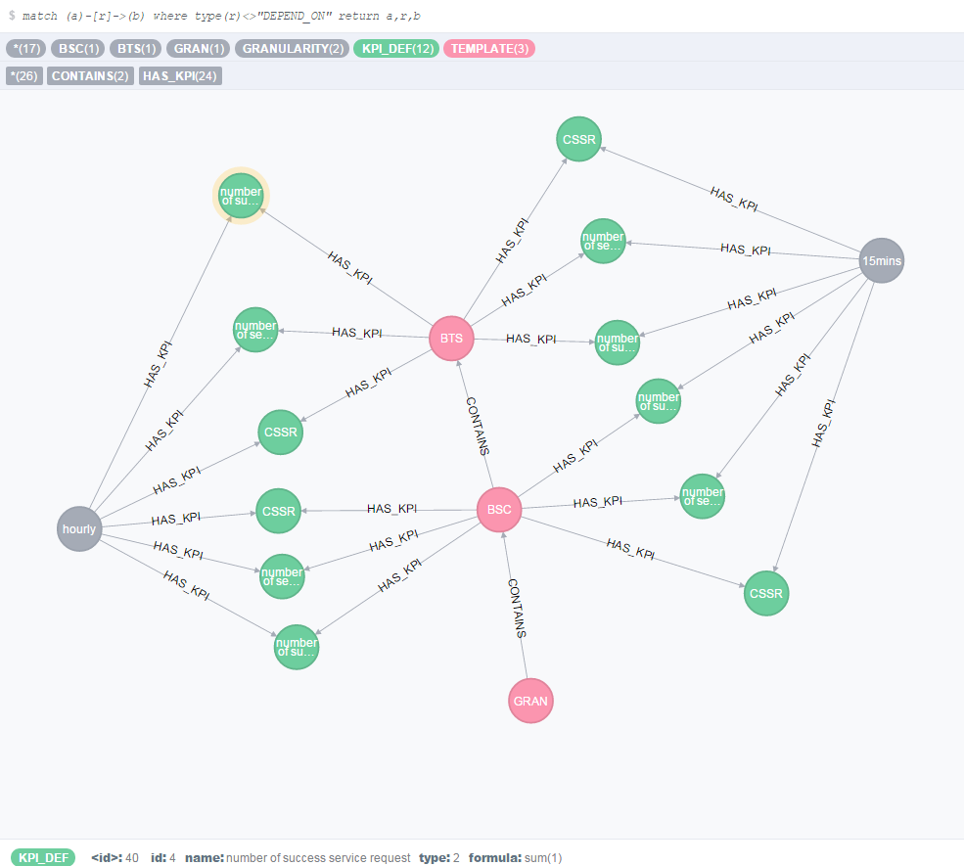
E2E Scenario definitions

Slide 7
Modeling
merge (:TEMPLATE:BSC {type:"BSC",desc:""}); merge (:TEMPLATE:BTS {type:"BTS",desc:""});
merge (:KPI_DEF {id:0,name:"number of service request",type:0,formula:"nbr_call_request"});
merge (:KPI_DEF {id:1,name:"number of success service request",type:0,formula:"nbr_call_response"});
BSC,BTS,TS,GRANULARITY,nbr_call_request,nbr_call_response BSC1,BTS1,100000000000,900,1,2 BSC1,BTS1,100000900000,900,1,2 BSC1,BTS1,100001800000,900,1,2 BSC1,BTS1,100002700000,900,1,2 BSC1,BTS2,100000000000,900,1,2 BSC1,BTS2,100000900000,900,1,2 BSC1,BTS2,100001800000,900,1,2 BSC1,BTS2,100002700000,900,1,2
CSV file
merge (:GRANULARITY {id:0,type:"15mins",num:900});

Slide 8
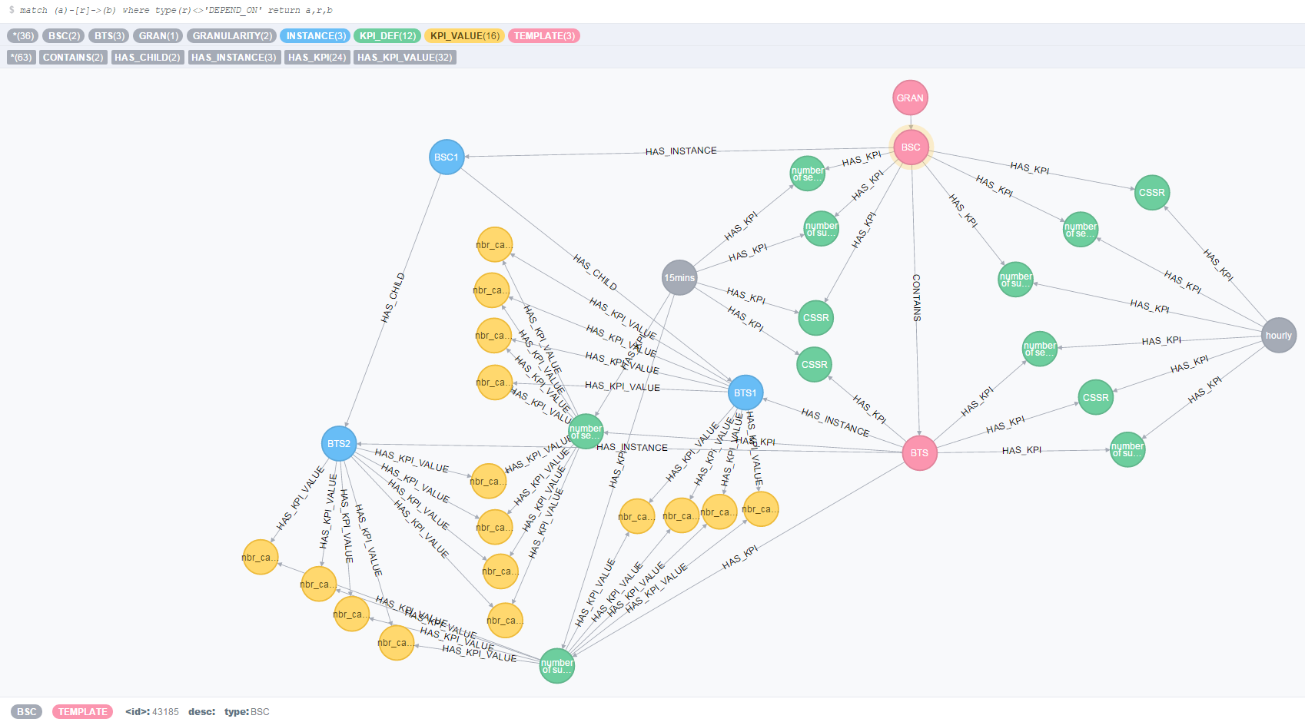
After collect

